Slide 1
Customer Retention Case Study Presentation
PREPARED BY RAHUL RANJAN

Slide 2

Agenda
Introduction
Problem Statement
Objective
Exploratory Data Analysis (EDA)
Visualization
Inference
Future Work

Slide 3
Introduction
What is Customer Retention and do we really need it?
"The capacity of a corporation to turn consumers into repeat buyers and keep them from moving to a rival is referred to as customer retention."
To put it another way, client retention entails "maintaining current consumers.”
This happens only if there exists a positive relation between the company and the customer.

Slide 4
What are the advantages of keeping customers?
Customers who have been with the firm for a long time are more likely to purchase additional services from them.
Customers that have been with you for a long time are believed to be less price/cost sensitive.
A 60-70 percent chance of selling to an existing customer exists.
The likelihood of selling to a fresh prospect is 5-20%.
Migration rates have slowed.
Getting a new client is more expensive than keeping an existing one.

Slide 5
Customer Retention Strategies to Help You Succeed
Find out what your consumers desire and why they remain or go.
Collect and promote client feedback in a proactive manner.
Analyse client feedback to acquire useful insights and make sure it reaches the proper people.
Make a move and Analyse the outcomes
Measure and track your consumers' loyalty and involvement on a regular basis.
Continue to inquire, listen, analyse, and improve.

Slide 6
Motivation for the Problem Undertaken
Consumer retention entails more than simply providing what the customer expects.
Exceeding client expectations may be necessary to create brand loyalists.
Customer loyalty is achieved by putting "customer value, rather than maximisation of profits and shareholder value, at the core of corporate strategy."
In a competitive climate, delivering a consistently high level of customer service is frequently the crucial differentiator.
Furthermore, retention is a crucial goal in the new world of Customer Success.

Slide 7
Problem Statement
Customer satisfaction has emerged as one of the most important factors that guarantee the success of online store; it has been posited as a key stimulant of purchase or repurchase intentions and customer loyalty.
A comprehensive review of the literature, theories and models have been carried out to propose the models for customer activation and customer retention.
Five major factors that contributed to the success of an e-commerce store have been identified as: service quality, system quality, information quality, trust and net benefit.
The research furthermore investigated the factors that influence the online customers repeat purchase intention.
The combination of both utilitarian value and hedonistic values are needed to affect the repeat purchase intention (loyalty) positively.
The data is collected from the Indian online shoppers. Results indicate the e-retail success factors, which are very much critical for customer satisfaction.

Slide 8
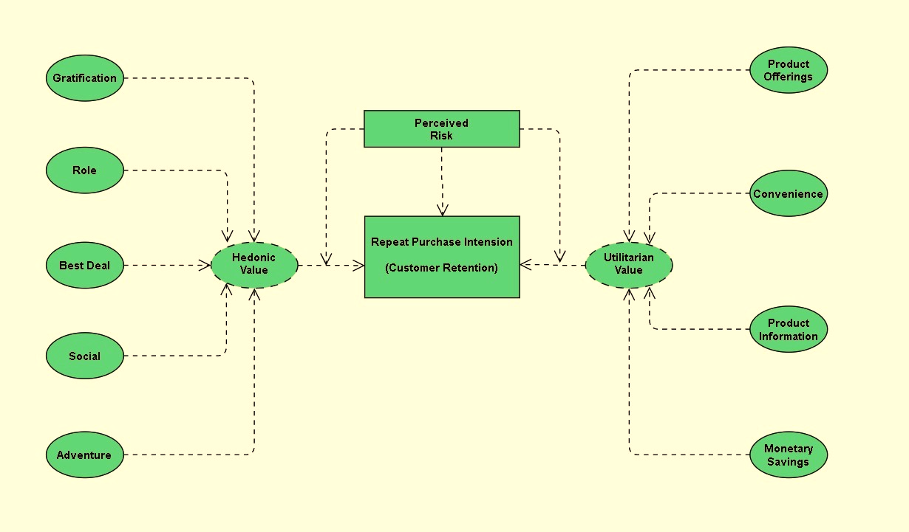
The problem statement can be represented in the form of below use case diagram as well.

Slide 9
Objective
The goal is to employ analytical abilities to come up with discoveries and conclusions that will enable an E-Retail firm forecast client retention utilizing data on customers collected over time.
I was given the responsibility of finding which elements were most significant in the loss of a valuable client using the model, and then devising a strategy for how the organization might use this knowledge to boost customer retention.

Slide 10
First, I loaded the complete dataset into our Jupyter Notebook and renamed the columns after importing the appropriate libraries. Then I looked at the layout of our data and saw that we had 269 rows and 71 distinct columns. In our dataset, there are no null or missing values. In our dataset, there are 22% duplicate records; nevertheless, rather than eliminating them, I elected to keep them. By looking at the data types, I discovered that all of the columns are of the 'object' data type, with the exception of the Pin Code column, which is of the 'integer' data type.
Shape : 269 rows and 71 columns.
No null values present.
22% duplicate fields/records found.
Datatypes of all the columns are objects except for the “Pin Code" column which has integers.

Slide 11





Data Description
The information was gathered from Indian internet shoppers. Our data collection includes consumer reviews and comments from Amazon, Flipkart, Snapdeal, Myntra, and Paytm, five of India's most popular online retailers.
With the purpose to suggest, a questionnaire is created based on brand strength, brand empathy or dedication, total consumer happiness, and perceived value for money.
The findings reveal the essential e-retail success elements for customer happiness and retention.
The top 5 Indian Online Retailers:

Slide 12
Visualization
What is the definition of data visualization? A graphical depiction of information and data is referred to as data visualization.
What are the advantages of good data visualization? Data visualization is another visual art approach that piques our interest and retains our attention on the message collected by the eyes.
There are several types of data visualization analysis:
1. Univariate Analysis: We will use a single characteristic to assess practically all of its attributes in a univariate analysis.
2. Bivariate Analysis: Bivariate analysis is when we compare data between two attributes that are precisely the same.
3. Multivariate Analysis: We shall compare more than two variables in the multivariate analysis.

Slide 13
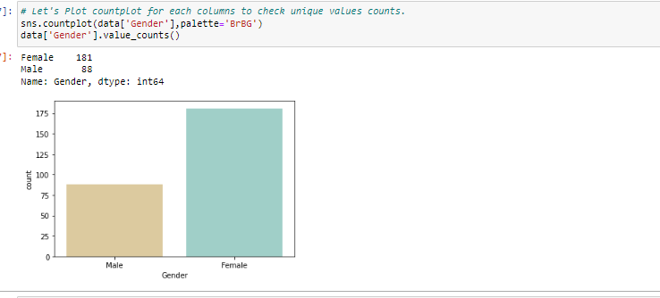
Univariate Analysis:
I was able to determine the total number of rows covered by each unique category value contained in all columns of our dataset using count plots. I made sure that the proportion of data coverage is presented with the overall row number.

Slide 14
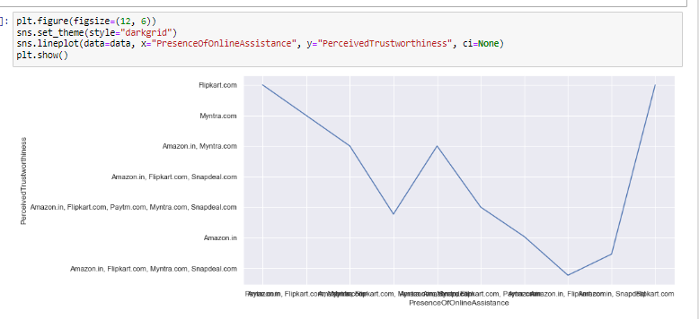
Bivariate Analysis:
I was able to provide analysis details comparing two columns of the dataset where the hue remained constant while the other one changed in a loop using the count plot and the hue parameter. The column is the color utilized in this plot, and the caption is displayed appropriately.

Slide 15
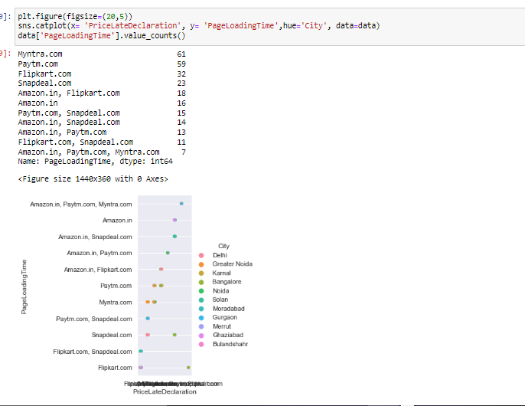
Bivariate Analysis:
I was able to provide analysis details comparing two columns of the dataset where the hue remained constant while the other one changed in a loop using the count plot and the hue parameter. The column is the color utilized in this plot, and the legend is displayed appropriately.

Slide 16
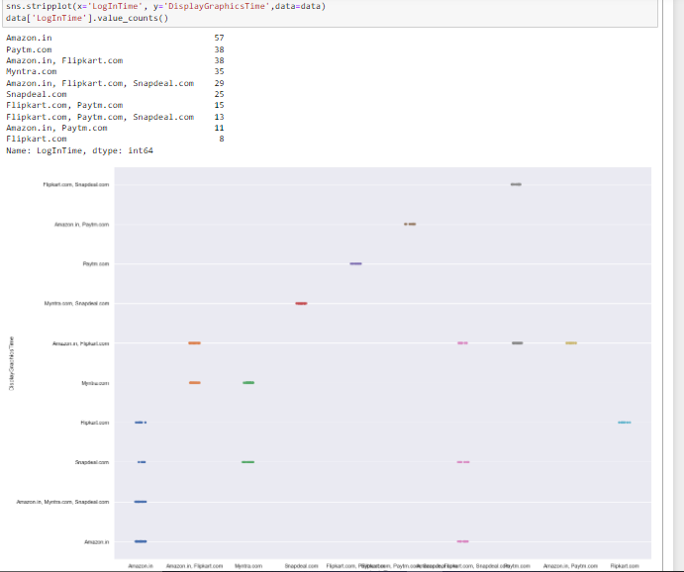
Bivariate Analysis:
I was able to provide analysis details comparing two columns of the dataset where the hue remained constant while the other one changed in a loop using the count plot and the hue parameter. The column is the hue utilized in this plot, and the legend is displayed appropriately.

Slide 17
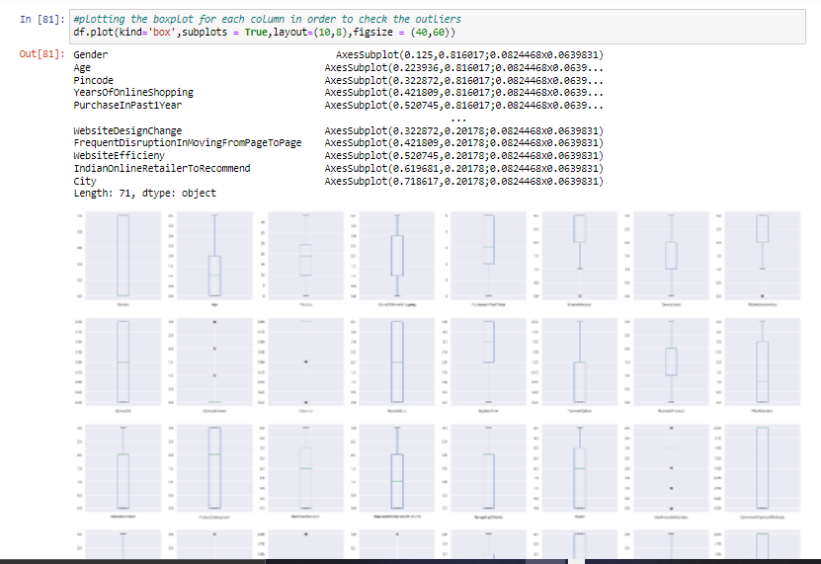
Multivariate Analysis:
After encoding all of the columns in our dataset, I utilized the histogram. The boxplot would not have created a diagrammatic representation of object datatype columns since it only understands numeric values. The information was shown as boxplot when the encoding was completed.

Slide 18
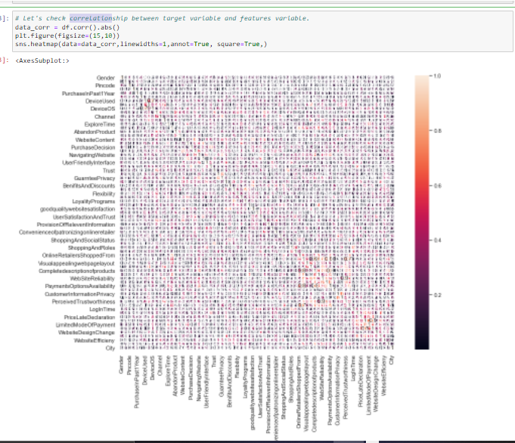
Multivariate Analysis:
To observe the correlation information between the columns, I utilized the heatmap on the encoded dataset. Even though the picture was too small to see on the Jupyter Notebook, I was able to deduce from the color choices that there is no multi collinearity between the columns.

Slide 19
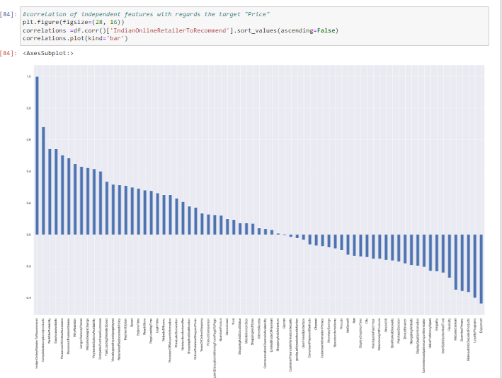
Correlation between the columns:
I created different bar plots using the correlation approach to verify the positive and negative correlation information in our dataset. A perfect positive correlation is shown by a correlation of +1, which means that both variables move in the same direction. A negative correlation of –1 implies a complete negative correlation, which means that when one measure rises, the other falls.

Slide 20
Inference
The first 47 aspects, based on general observations, give insights into how e-retail is beneficial and increasing based on consumer feedback. The data revealed which CITY, PIN CODE, AGE, and other variables were utilized most frequently on the web platform. It also revealed that some criteria are given less weight in contributing to the success of an e-commerce site, allowing us to eliminate such aspects while keeping all the vital ones. We might also improve on some of the elements that impact the likelihood of repeat purchases by internet clients.
Apart from the first 47 elements, the remaining features demonstrated which web platform was utilized more frequently depending on success factors. According to the customer activation and retention case study, Amazon is the most dependable and has met all of the consumer needs. Following Amazon, research indicated that Flipkart was utilized more for online shopping.
According to a case study of Indian e-commerce clients, Amazon and Flipkart are the most frequently utilized for online shopping and are the most frequently suggested by friends. So, based on the research considerations, Amazon and Flipkart are e-commerce platforms that combine utilitarian and hedonistic values to favorably influence recurrent purchase intent (loyalty).

Slide 21

1. Amazon
To be improved:
During promotions, attempt to provide clients with a stress-free shopping experience.
Provide customers with extra payment alternatives.
Give the pricing as soon as possible during the offer.
Shorten the time it takes for things to arrive.
Positive feedback summary:
It's easy to use, and it's also a fantastic buying site.
Products are delivered quickly.
Availability of comprehensive product information.
Multi-channel online assistance is available.
Trustworthy website or app, as well as perceived trustworthiness.
E-Commerce Company:

Slide 22

2. Flipkart
To be improved:
During promotions, attempt to provide clients with a stress-free shopping experience.
Provide customers with extra payment alternatives.
Give the pricing as soon as possible during the offer.
Shorten the time it takes for things to arrive.
The only difference between Flipkart and Amazon is that their feedbacks
are practically identical, with varied percentages.
Positive feedback summary:
It's easy to use, and it's also a fantastic buying site.
Products are delivered quickly.
Availability of comprehensive product information.
Multi-channel online assistance is available.
Trustworthy website or app, as well as perceived trustworthiness.
A wide range of items are available.
E-Commerce Company:

Slide 23
3. Myntra
Positive feedback summary:
It's easy to use and has an excellent webpage.
A variety of payment alternatives are available.
Products are delivered more quickly.
Detailed information on all available goods.
Trustworthy website or app, as well as perceived trustworthiness.
A wide range of products to choose from
To be improved:
During promotions, attempt to provide clients with a stress-free shopping experience
During promotions, try to offer the pricing as soon as possible.
During promotions, reduce the time it takes for things to arrive.
E-Commerce Company:

Slide 24

4. Paytm
To be improved:
During promotions, reduce the time it takes for things to arrive.
Give the pricing as soon as possible during the offer.
During promotions, attempt to provide clients with a stress-free
shopping experience.
Price and discount announcements are made late.
When moving from one page to the next, there is a lot of noise.
Positive feedback summary:
It's easy to use and has an excellent webpage.
The ability to finish a transaction in a timely manner.
About 64% of consumers believe that either the web or the app is
trustworthy.
Paytm is thought to have a wide range of items, according to 20% of
consumers.
E-Commerce Company:

Slide 25
5. Snapdeal
To be improved:
During promotions, reduce the time it takes for things to arrive.
Give the pricing as soon as possible during the offer.
During promotions, attempt to provide clients with a stress-free
shopping experience.
Price and discount announcements are made late.
No one has indicated a desire to promote Snapdeal to a contact since it
has the most number of negative reviews of any other website.
Positive feedback summary:
It's simple to use.
A total of 54% of consumers are satisfied with the provision of financial data security.
E-Commerce Company:

Slide 26

Analysis
Most of the customers are females with age from 20-50 and they used mobile internet to access with Windows as operating system.
And most of the customers used search engines to get into the platform first time and frequently.
Max customers uses there debit/credit cards for there payment.
Almost customers has a expectation to have Content_Readability, Similar_ProductInfo, Seller_ProductInfo, ProductInfo_Clarity, Ease_Navigation, Loading_ProcessingSpeed, UserFriendly_Interface, Conveninet_PaymentMode, TimelyFulfilment_Trust, Customer_Empathy, CustPrivacy_Guarantee, VariousChannel_Responses, Benefit_Discount, Enjoy_OnlineShopping, Convenience_Flexibility, Returns_ReplacementPolicy, Loyalty_ProgramAccess, QualityInfo_Satisfaction, WebsiteQuality_Satisfaction, NetBenefit_Satisfaction, User_Trust, Product_SeveralCategory, Relevant_ProductInfo, Monetary_Savings, Patronizing_Convenience, Adventure_Sense, Enhances_SocialStatus, Gratification_Shopping, Role_Fulfilment, Money_Worthy in e-commerce websites.

Slide 27
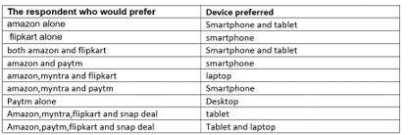
The system and device used by the costumer

Slide 28
Observations
Female customer often prefer to purchase more as compared to Male customer
People between 21 to 50 years of age tends shops more.
Dataset appears to have approximately 67% of Female respondents & 32 % of Male
Delhi has maximum count which means in Delhi the online purchase is high.
Mobile screen size has maximum count for others,and 2nd most count is for 5.5 which is the most used screen size.
Customers with OS windows/windows mobile are more in number,as it's the most common OS.
Most of the customers uses chrome browser, which seems to be best in market and easy to use.
Most of the customers used Search engine to reach there favorite online store for the first time , as search engine shows variety of similar product from n-number of sites.
After first visit most of the customers are reaching the online store through Search engine, Via application and Direct Url.
Most of the customers are exploring the e-retail store more than 6 mins before making purchase decision (checking all info and deciding which one to buy usually take time).
Maximum customers are using credit/debit cards for there payment(most convenient and easy to use).
Amazon and flipkart is performing best in all given parameter

Slide 29
Conclusion
After the detailed analysis of problem I found the following conclusions:
Frequency of Females shoping is high so making them satisfied will help the sellers to get more business.
Loyal customers prefer buying and tend to spend more money on shopping in your store. Statistics show that engaged consumers purchase more frequently. It is necessary to hear customer feedback because most of them are valuable feedbacks.
Sometimes customer feedback is the best marketing strategy. They are frequent customers so they will know which areas of your business may well be improved. If their feedback is approved, they will extremely excite and support your company with their best ability.
It found that Amazon and Flipkart are standing best out in the market by using ethical, reasonable business strategies
The repeat purchase intention (loyalty) positively, Structural equation model has been presented on the primary data collected from the Indian online shoppers.
Here as an conclusion part I found that using dead old strategies for retailers will effect customer retention.

Slide 30


